Slide 1
Gross Fixed Capital Formation (GFCF)
Buyung Airlangga

Slide 2
Coverage of Gross Domestic Capital Formation (GDCF)
GDCF consist of:
  GFCF = Gross fixed capital formation
  changes in inventory
  acquisition less disposals of valuables, or net acquisition of valuables

Slide 3
Gross Fixed Capital Formation (GFCF)
Coverage :
Non-financial fixed capital formation, such as:
  purchase/barter/transfer of fixed capital (new and imported second-hand)
  Owned final use of fixed capital
  Fixed capital acquired from leasing (financial lease)
  Major repair & improvement of fixed capital and historical monuments

Slide 4
GFCF... (2)
  Natural growth of cultivated assets which is harvested repeatedly (raising of dairy cattle, growing of perenial crops, etc.)
Major repair & improvement of tangible non- produced assets
Costs incurred in transfer of ownership of non- produced assets

Slide 5
GFCF ... (3)
  Dispositions of GFCF consist of:
    Sold of fixed asset
    Internal transaction (barter)
    Capital transfer

Slide 6
Some notes:
Fixed capital used repeatedly in production process includes: animals, crops, etc.
  Treated as inventory while growing
  Treated as fixed asset as soon as they produced output
  Death or decreased productivity treated as consumption of fixed capital (CFC)
  Fixed capital obtain trough purchase, barter, capital transfer and final own used are consider as GFCF

Slide 7
Notes … (2)
Capital formation on non-produced asset is cost of ownership transfer
Household durable goods used for household unincorporated enterprise must be allocated to Gross Domestic Capital Formation (GDCF)
Household durable goods used for own-final consumption is treated as Household Final Consumption Expenditure (HFCE), except for dwelling

Slide 8
Types of GFCF
Tangible assets:
  Residential House
  Dwelling other than residential house
  Machinery and equipment
  Cultivated assets, such as crops and livestock
Intangible assets:
  Mineral Exploration
  Computer software
  Entertainment, literary or artistic originals
  Other intangible asset
Major improvement on non-produced tangible assets (particularly land)
Cost related to transfer of ownership on non-produced assets (such as land, patents, etc.)

Slide 9
Border line cases
GFCF includes:
  Boathouse, caravan and other structure such as garage etc. which is use as shelter
  Structure and tools/equipment used by military (also civilians) such as airport, helipad, shipping dock, road and hospital.
  Small weaponry, vehicle used by military and civilians
  Addition to livestock used repeatedly/ simultaneously for production (such as dairy cattle, sheep raised for its fur, laying hens, etc.)
  Addition to cultivated crops harvested repeatedly, such as fruit crops, rubber plants, coconut plants, etc.
  Major repair and maintenance that prolong economic live of assets
  Addition to fixed assets acquired from leasing (financial leasing)

Slide 10
Border line cases
Not includes GFCF:
  Transaction intended as intermediate consumption: acquisition of auxiliary equipments (small tools); minor/routine maintenance or repair; fixed asset acquired from operational leasing contract
  Transactions as part of changes in inventory: feedlot animals intended for slaughtered, including poultry; perennials cultivated for timber wood(work-in-progress)
  Machinery and equipment intended for household final consumption expenditure
  Holding gains and losses on fixed assets as other changes in assets
  Losses due to natural disaster (flooding, forest fire, etc.), damage or plague of productive plants, etc.

Slide 11
Intangible fixed assets
Mineral exploration, actual cost of test drilling, field survey (aerial or other surveys), transportation cost, etc.
Computer software and database used in production more than a year.
Literary and artistic originals of manuscripts, renderings, models, films, sound recordings, etc.
Cost of changing ownership such as:
  Cost incurred in delivering asset (new or second hand) to destinated location, such as: transportation cost, installation cost, etc.
  Professional or commission fee, such as: fees related to surveyors, engineer, lawyer, appraisal, etc., and commissions to broker, auction committee, etc.
  Taxes paid by owner related to transfer of ownership

Slide 12
Land improvement
Land reclamation, construction of waves barrier, dam, etc.
Forest, hill, mountain clearings for production of agriculture, plantation, etc.
Construction of sewerage, irrigation, etc.
Construction for flood management, erosion control, etc.

Slide 13
Timing and valuation of GFCF
Time recording
  As transfer of ownership of fixed assets
  Modification needed if:
    Assets acquired trough leasing (financial lease)
    Own-account fixed capital formation
Valuation
  Recorded at purchaser’s price, including installation and other transfer ownership costs
  Recorded at basic price or at costs plus mark-up for net operating surplus or mixed income if own production assets

Slide 14
Methodology
Two approaches:
  Conventional approach by collecting information from business and public sectors – mainly based on commercial accounting practices
  Commodity flow – estimate supply (output plus net imports of products that allocated to final demand components. Caution on the difference between Parts of capital goods and Partly capital goods.

Slide 15
Data sources
Output of construction at current & constant prices;
GFCF in the forms of machineries, transports, and other fixed capital from 2006 economic census;
Survey on fixed capital;
Implicit index of GFCF in the forms of machineries, transports, and other fixed capital

Slide 16
Flowchart
Output construction at current price
Ratio of output construction that become fixed capital
GFCF of construction at current price
GFCF at current price
GFCF other than construction from 2006 EC (as benchmark)
growth value based on surveys and financial statements
GFCF of machineries, transports, and other fixed capital at current price

Slide 17
Flowchart (2)
Output construction at constant price
Ratio output construction that become fixed capital
GFCF of construction at constant price
GFCF at constant price
GFCF of machineries, transports, and other fixed capital at current price
Implicit index of GFCF
GFCF of machineries, transports, and other fixed capital at constant price

Slide 18
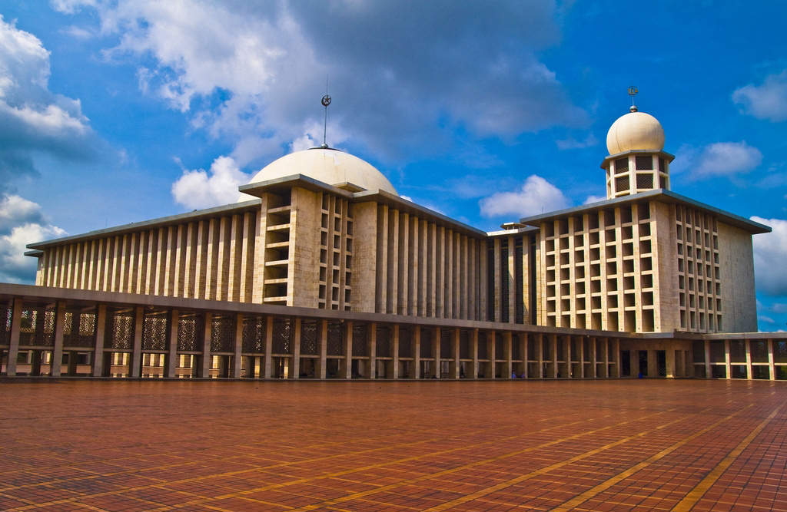
Thank you

